Slide 1

EDA ANALYSIS
Credit Card Customer Churn

Slide 2

Problem Statement: Customers’ leaving credit cards services would lead bank to loss, so the bank wants to analyse the data of customers and identify the customers who will leave their credit card services and reason for same – so that bank could improve upon those areas.
Customers leaving credit card services leads to bank losses.
Goal: Analyze customer data to identify who is likely to churn and why.
Objective: Prevent future churn by improving identified problem areas.

Slide 3
Dataset Analysis:
By Observing dataset there are some key variables:
Attrition_Flag: Target variable indicating if customer attrited ("Attrited
Customer") or remained ("Existing Customer")
Demographic variables: Customer_Age , Gender, Dependent_count,
Education_Level,Marital_Status
Financial variables: Income_Category, Card_Category, Credit_Limit,
Total_Revolving_Bal
Behavioral variables: Months_on_book, Total_Relationship_Count,
Months_Inactive_12_mon,Contacts_Count_12_mon
Transaction variables: Total_Trans_Amt, Total_Trans_Ct,
Avg_Utilization_Ratio

Slide 4
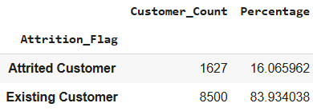
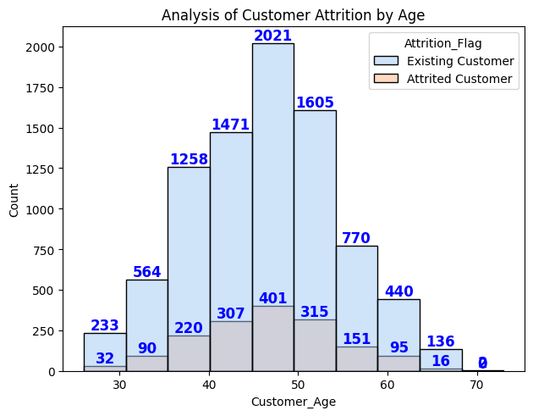
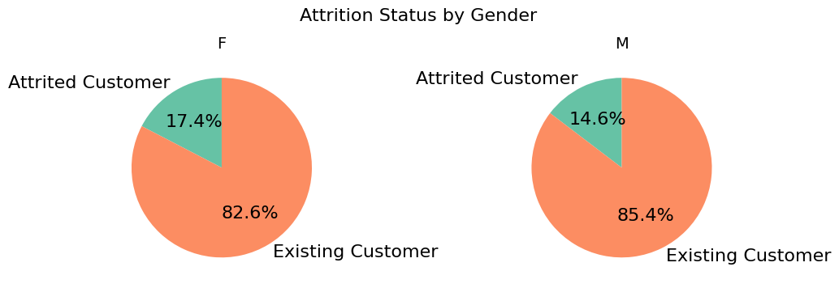
ATTRITION FLAG:
Majority are existing customer with the 84% and attrited customer with only 16%.By these we can say that only minority customer opted out for credit card service.
ANALYSIS ON DEMOGRAPHIC VARIABLES:
1.Gender Disparity in Attrition: Female customers exhibit a higher attrition rate (17.4%) compared to males (14.6%), suggesting potential gaps in service or product alignment for women.
2.Retention Advantage for Males: Male customers show stronger loyalty with 85.4% retention versus 82.6% for females, highlighting a need to address female-specific churn drivers
Majority customers between 40 to 60 age group and Most churn rate between 40 to 60 age group.

Slide 5
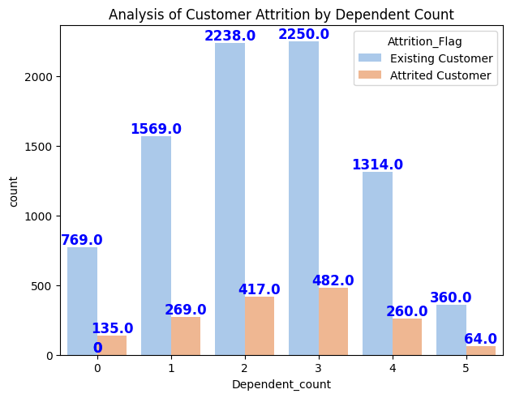
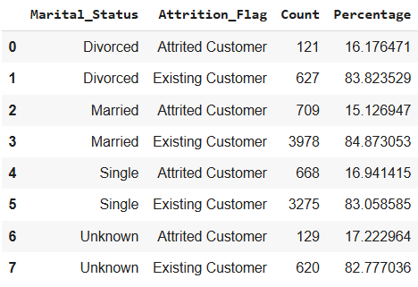
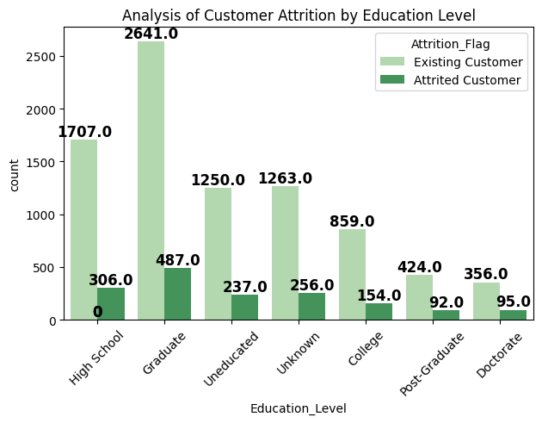
Attrition Range: 14.6%–17.6% across dependent counts; highest at 17.64% for 3 dependents.
Education: Doctorate holders attrition most (21.06%); College/High School/Graduate retain best (~85%).
Marital Status: Married most loyal (15.13% attrition); Unknown status highest risk (17.22%). Singles/Divorced ~16–17%.
Stability: Unknown/Uneducated slightly less stable (16.85%, 15.94%).

Slide 6
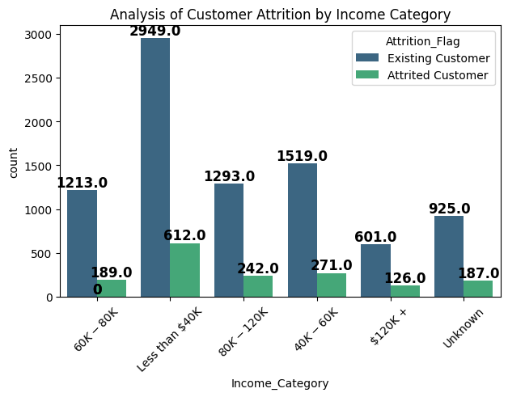
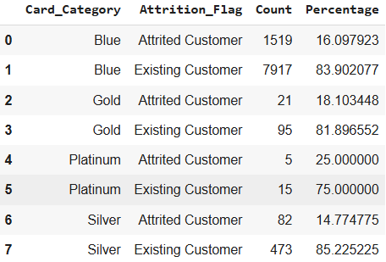
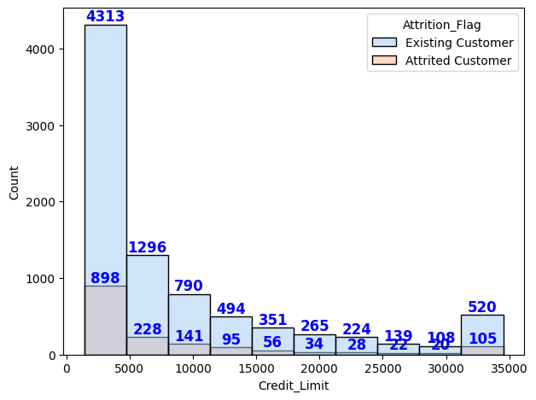
ANALYSIS ON FINANCIAL VARIABLES:
Income <$40K: High customer base but high attrition, suggesting dissatisfaction in lower-income groups.
Income $120K+: Elevated attrition despite high income, possibly due to unmet expectations or better competitor offers.
Platinum cardholders: Highest attrition rate at 25%, indicating premium customer dissatisfaction.
Blue cardholders: Largest group with moderate attrition (16%), reflecting average loyalty.
Silver cardholders: Best retention rate (85.2% attrition).
Credit limit <$5K: Highest churn risk among low-limit customers.
Credit limit ≥$15K: Strong retention, showing loyalty in high-limit segments.

Slide 7
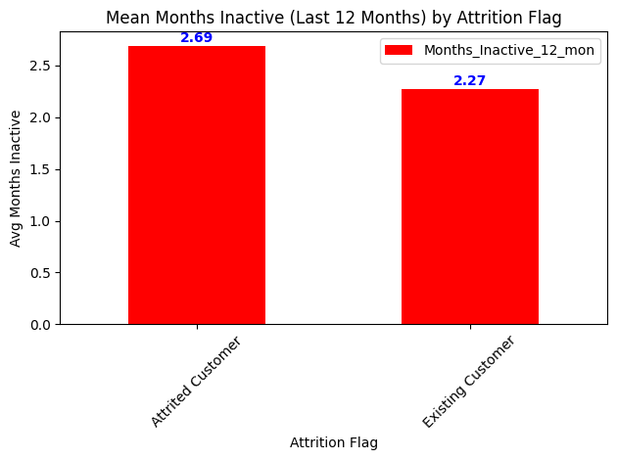
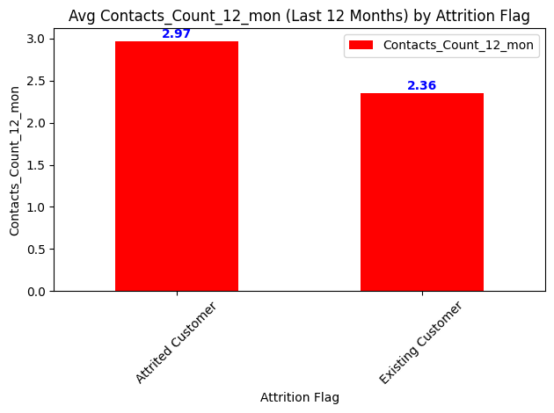
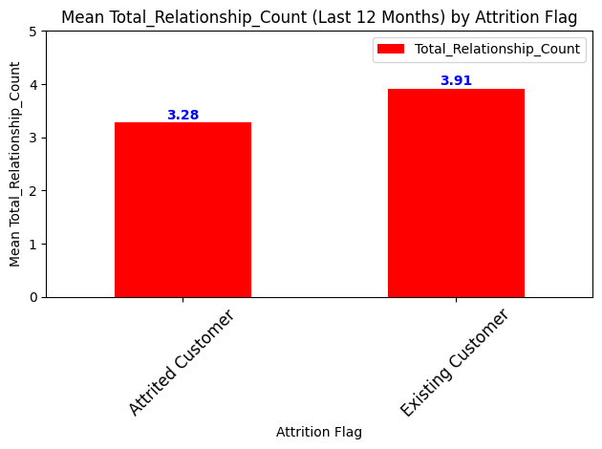
ANALYSIS ON BEHAVIORAL ANALYSIS :
Attrited customers were inactive for a longer average duration (2.69 months).
Existing customers showed slightly better engagement (2.27 months inactive).
Attrited customers contacted the bank more frequently (2.97 times/year).
Existing customers reached out less (2.36 times/year).
Higher contact frequency may indicate unresolved issues or dissatisfaction.
Existing customers have a higher average relationship count (3.91) than attrited ones (3.28).
Stronger engagement appears to correlate with customer retention.

Slide 8
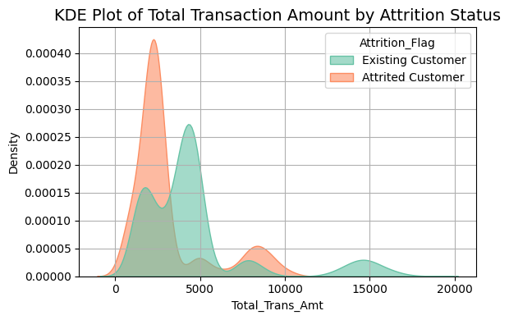
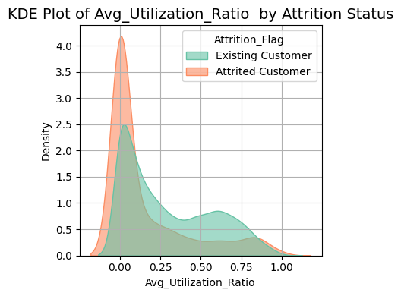
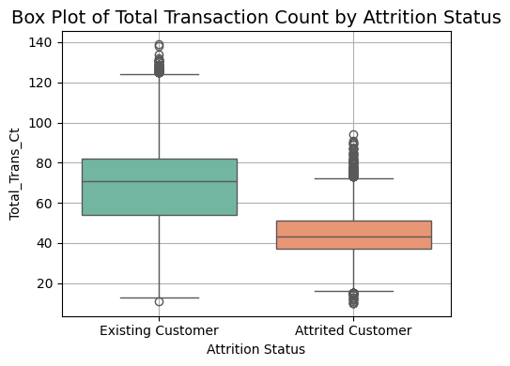
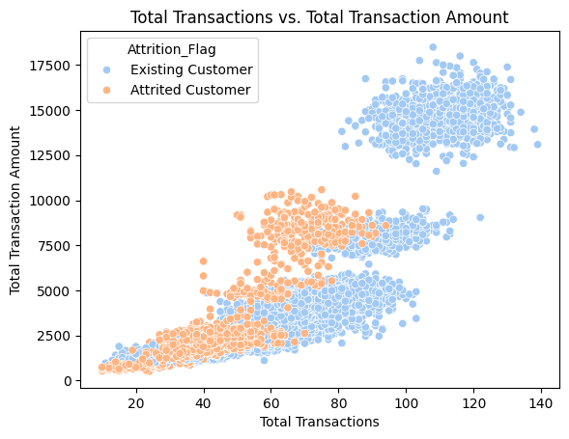
ANALYSIS ON TRANSACTION ANALYSIS:
Transaction patterns: Existing customers show multiple high-value transaction peaks, while attrited customers peak only at lower amounts (2500-3000), indicating reduced spending before churn.
Engagement levels: Existing customers demonstrate frequent usage (peaking at ~75 transactions) versus attrited customers' limited activity (~40 transactions).
Spending correlation: Higher transaction counts/amounts in existing customers reveal a positive link between engagement and retention.
Credit utilization: Attrited customers cluster near zero utilization, while existing customers show broader, higher usage, reflecting deeper financial involvement.
Behavioral insight: Lower transaction activity and credit utilization signal impending attrition, contrasting with active customers' robust financial engagement.

Slide 9
RECOMMENDATIONS:
Target high-risk groups: Focus on customers aged 40-60, those with 2-4 dependents, and doctorate holders (21% churn)
Develop marital status-based engagement: Strengthen outreach to single/divorced and "unknown" status customers
Implement financial wellness programs: Offer support for customers showing financial strain
Provide credit counseling: Introduce budgeting tools to help manage revolving balances
Improve data collection: Reduce "unknown" marital status entries for better targeting
Launch loyalty rewards: Incentivize long-term customers in the 40-60 age bracket
Analyze transaction patterns: Identify service gaps from churned customers' data
Optimize credit products: Review and adjust credit limits and utilization ratios

Slide 10

THANK YOU

